Slide 1

Business Intelligence and Analytics
A Comprehensive Overview
Abed Bakkour
Rizny Mubarak
Siju A
Bincy Babu
Notes:
Concepts, Applications, and Trends BI/Analytics, often referred to as 'BI,' are essential for making smart decisions. They help organizations use data effectively.

Slide 2
What is BI and Analytics?
Business Intelligence
Analytics
Involves the systematic exploration of data through statistical, mathematical, and computational methods. It aims to extract valuable insights and make predictions, facilitating data-driven decision-making.
Represents a comprehensive framework of processes, technologies, and tools designed to collect, process, and analyze data. Its primary aim is to transform raw data into meaningful information for informed decision-making.

Slide 3
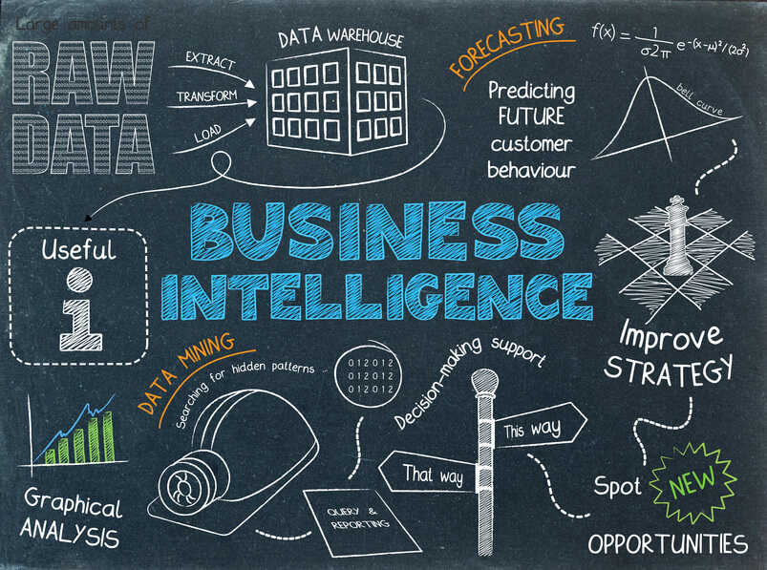
Business Intelligence
Data collection
Data modeling
Data warehousing
Reporting
The process of gathering raw data from various sources, such as databases, spreadsheets, and external systems. It's the foundation of any BI system
The practice of storing data in a centralized repository designed for efficient retrieval and analysis. It provides a structured foundation for reporting and analysis
The creation of logical and physical models to structure data in a way that supports efficient querying and reporting
The generation of meaningful reports, dashboards, and visualizations that provide insights and support informed decision-making.

Slide 4
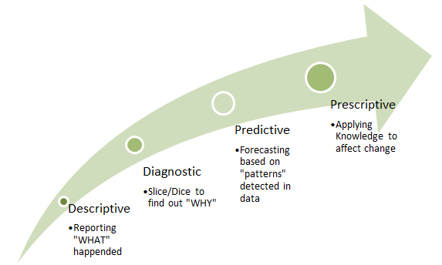
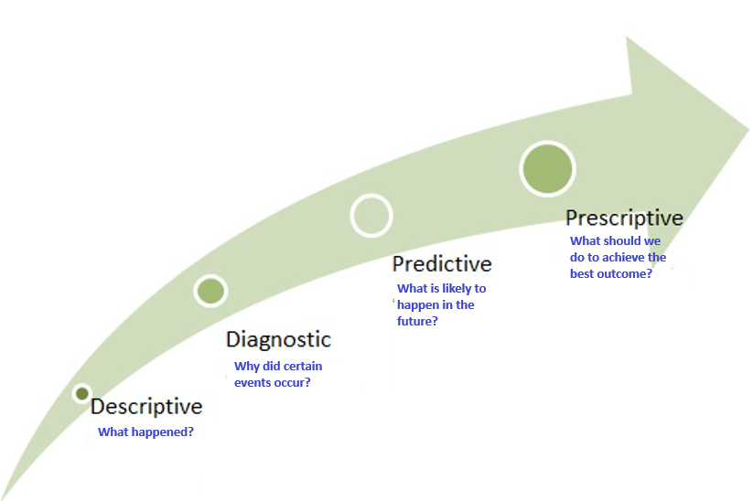
Analytics
Descriptive
Prescriptive
Summarizing and visualizing data to provide a clear understanding of historical events and trends.
Helps identify the root causes of problems by examining historical data. It helps answer the question.
leverages statistical and machine learning techniques to forecast future trends and outcomes. It answers the question.
Goes a step further by suggesting possible actions to optimize decision-making based on predictive insights.
Diagnostic
Predictive

Slide 5
Why is BI/Analytics Needed?
Informed Decision-Making
Competitive Advantage
Efficiency
Predictive Analysis
Data Integration
Performance Monitoring
Customer Insights
Risk Mitigation
Chaudhuri, S., Dayal, U., and Narasayya, V. (2011). An Overview of Business Intelligence Technology, Communications of the ACM, Vol 54(8), pages 88-98
Chen, H., Chiang, R. H. L., & Storey, V. C. (2012). Business Intelligence and Analytics: From Big Data to Big Impact. MIS Quarterly, 36(4), 1165-1188.
Davenport, T. H. (2010). Business intelligence and organizational decisions. International Journal of Business Intelligence Research, 1(1):1-12, January-March.
Watson, H. (2013). All About Analytics. International Journal of Business Intelligence Research, 4(1), 13-28, January-March.
Notes:
BI and Analytics are essential for businesses as they offer actionable insights from data, enabling informed decision-making and performance enhancement. descriptive - describe what has occurred e.g.,: reporting, OLAP, dashboards/scorecards, and data visualization predictive, - what will occur in the future e.g.,: regression analysis, machine learning, and neural networks (called data mining)prescriptive analytics - show whatshouldoccur.eg: used to optimize system performance.
Informed Decision-Making: BI allows organizations to gather and process data to make informed decisions. It will show evidence-based strategies that can enhance operations and identify areas for improvement.
Competitive Advantage: By understanding customer behaviour and market trends, BI provides a competitive edge to the business. It helps companies to respond promptly to market changes and customer needs, which improving customer satisfaction.
Efficiency Improvement: BI streamlines operations by identifying inefficient processes or areas where cost savings can be achieved. This enhances efficiency and resource allocation.
Predictive Capabilities: Analytics offer predictive models to forecast trends, customer behaviour, and potential business outcomes. This foresight helps in proactively addressing issues and seizing opportunities.
Data Integration: Integrates data from various sources for comprehensive insights. The data over which BI tasks are performed often comes from different sources—typically from multiple operational databases across departments within the organization, as well as external vendors Different sources contain data of varying quality, use inconsistent representations, codes, and formats, which have to be reconciled. There are several popular frontend applications through which users perform BI tasks: spreadsheets, enterprise portals for searching, performance management applications that
Performance Analysis: BI helps in evaluating business performance by providing insights into various operational aspects. This aids in optimizing processes, identifying market trends, and assessing the effectiveness of strategies.
Understanding Customer Insights: BI enables businesses to understand their customers better by analyzing their preferences, behaviours, and needs. This knowledge can lead to better-tailored products or services, thereby improving customer satisfaction. Major e-commerce entities like Amazon and eBay have revolutionized markets through their advanced platforms and product recommendation systems, influencing significant market changes. Analytical techniques like association rule mining and database segmentation are used for product recommender systems, allowing personalized recommendations and reaching niche markets efficiently.
Risk Management: Analytics tools help in risk assessment, enabling companies to mitigate potential risks by identifying patterns or anomalies that might lead to problems.

Slide 6
Application Areas for BI/Analytics
Marketing
Finance
Healthcare
Retail
Operations
Chaudhuri, S., Dayal, U., and Narasayya, V. (2011). An Overview of Business Intelligence Technology, Communications of the ACM, Vol 54(8), pages 88-98
Chen, H., Chiang, R. H. L., & Storey, V. C. (2012). Business Intelligence and Analytics: From Big Data to Big Impact. MIS Quarterly, 36(4), 1165-1188.
Davenport, T. H. (2010). Business intelligence and organizational decisions. International Journal of Business Intelligence Research, 1(1):1-12, January-March.
Wixom, B. and Watson, H. (2010). The BI-Based organization. International Journal of Business Intelligence Research, 1(1): 13-28, January-March.
Notes:
Now that we've established why BI and Analytics are needed, let's explore the diverse application areas where they play a vital role.
Marketing: BI and Analytics empower businesses to analyze customer data, track marketing campaign effectiveness, and personalize marketing strategies. For example, a company like Netflix uses customer viewing habits to recommend personalized content, as demonstrated in the paper by Chen et al. (2012). This enhances user satisfaction and loyalty.
Finance: In the financial sector, risk analysis and fraud detection are critical. Financial institutions employ Analytics to detect unusual patterns in transactions and assess credit risks. This ensures the security of customer assets and the stability of financial systems, as highlighted in the paper by Davenport (2010).
Healthcare: BI and Analytics are transforming patient care, clinical operations, and research in healthcare. Healthcare facilities use Analytics to predict disease outbreaks, optimize resource allocation, and improve patient outcomes, as illustrated in the paper by Chaudhuri et al. (2011). Predictive analytics can help hospitals anticipate patient admission surges during flu seasons.
Retail: Retailers benefit from BI and Analytics to optimize inventory management, analyze sales trends, and enhance the shopping experience. Amazon, for example, uses BI to predict what customers might want to purchase, as highlighted in the paper by Chen et al. (2012). This improves the overall shopping experience and increases sales.
Operations: Operations in various industries, such as manufacturing and logistics, are optimized through real-time data monitoring. BI dashboards track machine performance, predict maintenance needs, and streamline production processes. This leads to reduced downtime, increased productivity, and cost savings, as discussed in the paper by Wixom and Watson (2010).
By understanding these application areas, we can see that BI and Analytics are versatile tools that can be tailored to meet specific business needs across different sectors, ultimately driving efficiency and competitiveness.

Slide 7
BI/Analytics evolution?
Historical Perspective: BI&A 1.0 (DBMS-based, structured content): Utilized Relational Database Management Systems (RDBMS) and data warehousing for structured data storage. Employed ETL (Extract, Transform, Load) processes and OLAP (Online Analytical Processing) for data processing and analysis. Introduced dashboards, scorecards, data mining, statistical analysis, ad hoc query, and search-based BI for decision support. Implemented reporting, interactive visualization, and predictive modeling using column-based DBMS and in-memory DBMS technologies. Real-time decision-making capabilities were introduced, enhancing responsiveness. | Big Data Era: BI&A 2.0 (Web-based, unstructured content): Adapted to web-based platforms, focusing on unstructured content. Introduced information retrieval and extraction techniques. Implemented opinion mining, question answering, web analytics, and social media analytics for insights from online sources. Social network analysis and spatial-temporal analysis provided deeper understanding of social interactions and geographical patterns. Utilized natural language question answering and content/text analytics for extracting insights from textual data. | Advanced Technologies: BI&A 3.0 (Mobile and sensor-based content): Integrated mobile and sensor-based technologies for data analysis. Enabled location-aware analysis, allowing businesses to understand geographical influences on data patterns. Implemented person-centered analysis, tailoring insights based on individual user behavior and preferences. Context-relevant analysis provided insights contextualized to specific scenarios or events. Introduced mobile visualization and Human-Computer Interaction (HCI) techniques to enhance user experience. Mobile BI became prevalent, ensuring accessibility and real-time insights on mobile devices.

Slide 8
BI/Analytics evolution?
Historical Perspective:
Traditional Reporting: In the past, businesses relied on printed reports and basic charts generated from structured databases. E.g., monthly sales reports were generated to track revenue .
Emergence of Business Intelligence: With the rise of data warehouses and online analytical processing (OLAP) systems, businesses could create interactive reports and conduct multidimensional analysis. E.g., retailers started analyzing sales data by region, product categories, and customer segments to optimize inventory and marketing strategies.
Big Data Era:
Data Explosion: With the growth of the internet, social media, and IoT devices, businesses faced an overwhelming amount of data. For example, social media platforms generate vast volumes of unstructured data through user interactions, requiring advanced analytics tools to extract meaningful insights.
Challenges :Processing unstructured data such as text, images, and videos. Opportunities: Sentiment analysis of social media posts to understand customer opinions and preferences. For instance, companies like Netflix analyze user viewing patterns to recommend personalized content, enhancing customer satisfaction and retention.

Slide 9
BI/Analytics evolution?
Advanced Technologies
Machine Learning: E-commerce platforms like Amazon utilize machine learning algorithms to analyze customer browsing history and suggest products, increasing sales and customer engagement. Machine learning also powers fraud detection systems in banking, flagging suspicious transactions in real-time to prevent financial losses.
Artificial Intelligence: AI-driven chatbots in customer service analyze customer queries and provide instant responses, improving user experience. Virtual assistants like Siri and Alexa use natural language processing to understand voice commands, demonstrating AI's real-world applications.
Predictive Analytics: Airlines use predictive analytics to optimize ticket pricing based on historical demand patterns and competitor pricing. By forecasting demand, airlines can adjust ticket prices dynamically, maximizing revenue while ensuring flights are well-filled.

Slide 10
Conclusion
Decision-Making
Efficiency
Competitiveness
Notes:
To wrap up, we've delved into the fundamentals of Business Intelligence and Analytics, exploring what they are, why they are indispensable, where they find application, and how they have evolved over time. The insights we've gained today underscore the critical role of BI and Analytics in modern organizations and their impact on decision-making, efficiency, and competitiveness.

Slide 11
Thanks for your attention

